Slide 1
Goals
Introducing new features which will delight customers, thereby engage and retain them on our platform.
What will be the success metric to measure its performance?
Subhadip Samanta
IIFT Delhi

Slide 2
Context
About
CureFit is a health and ﬁtness company offering digital and oﬄine experiences across ﬁtness, nutrition, and mental well-being. Cult.ﬁt is a chain of workout centers across India under CureFit brand.
Assumptions
Daily Active User : 90,000*
Monthly Active User : 100,000*
200K new users joined in one week of launch**.
Over 15k users are doing live yoga and meditation classes every day while this number has seen a 10X increase over the past few weeks.***
*https://www.ﬁnancialexpress.com/industry/technology/health-ﬁtness-apps-see-more-downloads-amid-lockdown/1920723/
**https://startup-monk.com/ﬂipkart-maﬁa-cureﬁt-making-india-ﬁt/
***https://inc42.com/buzz/startupsvscovid19-ﬁtness-yoga-go-online-in-india-as-apps-take-over-from-gyms/

Slide 3
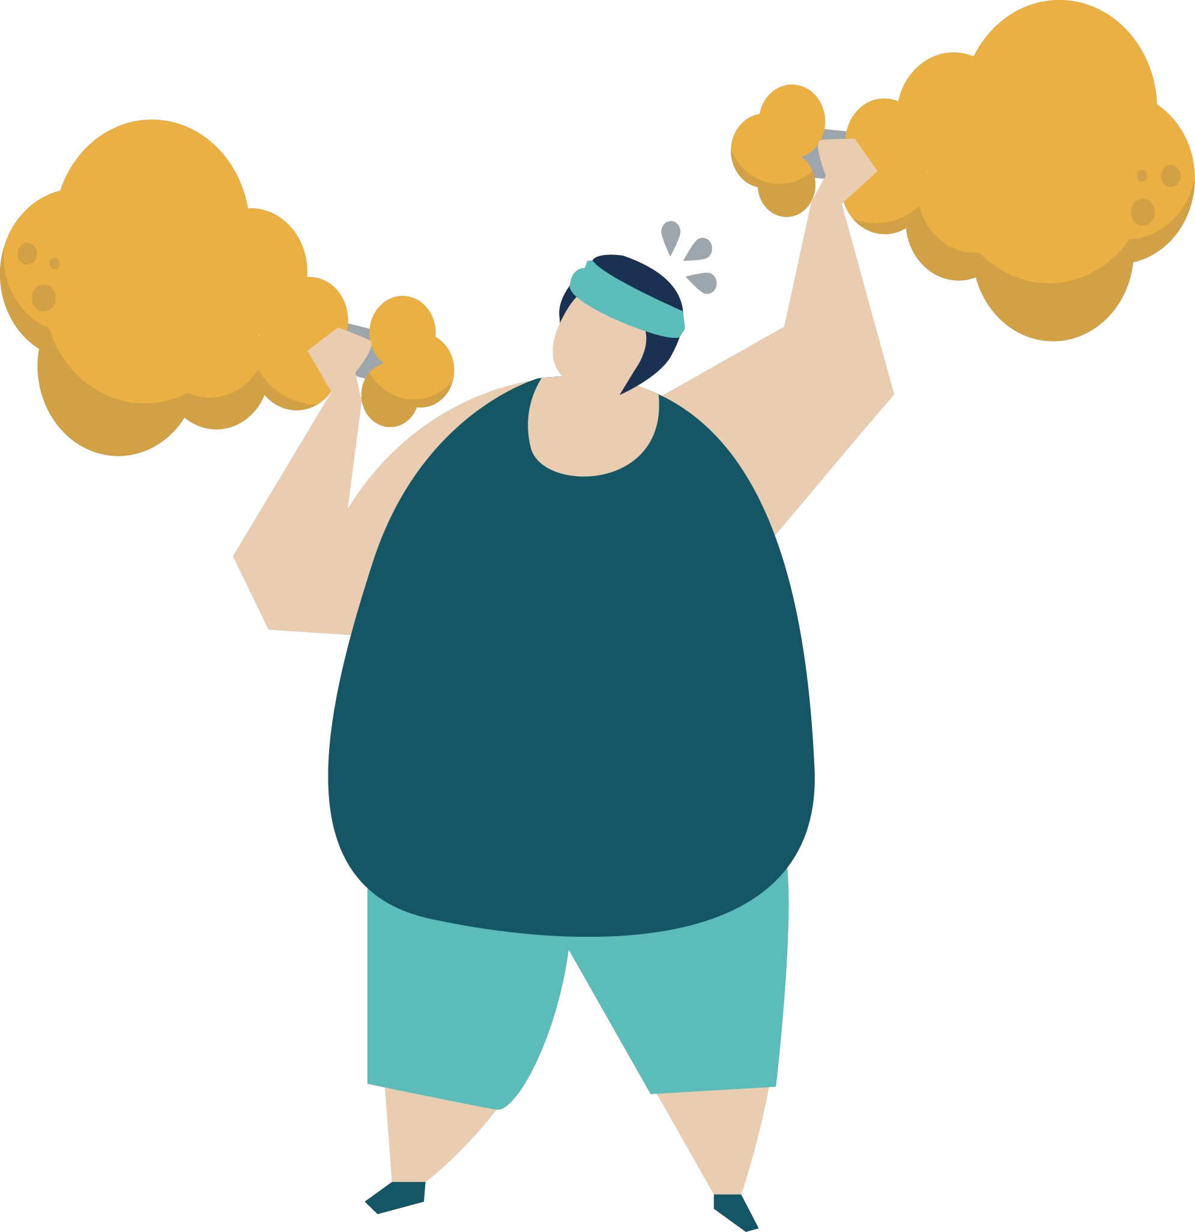
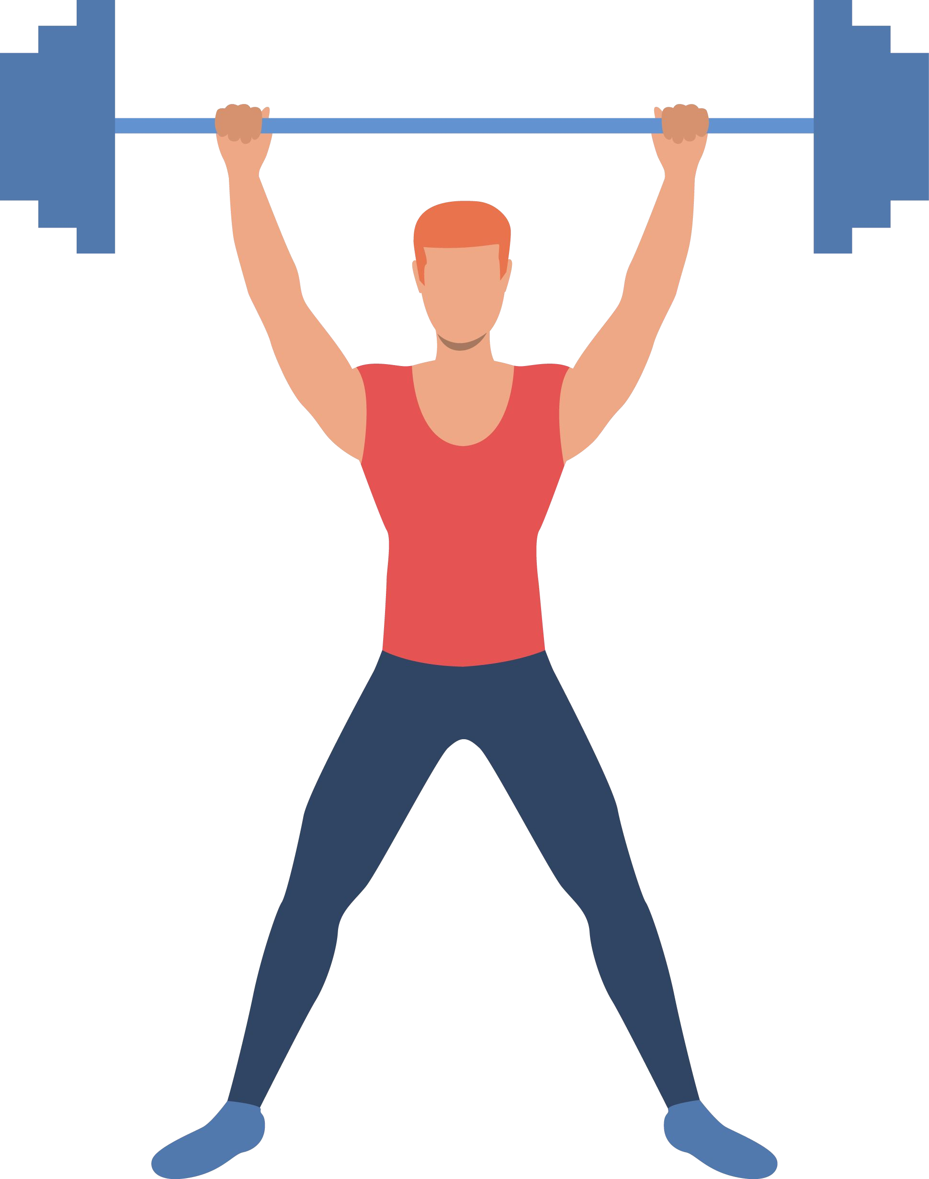
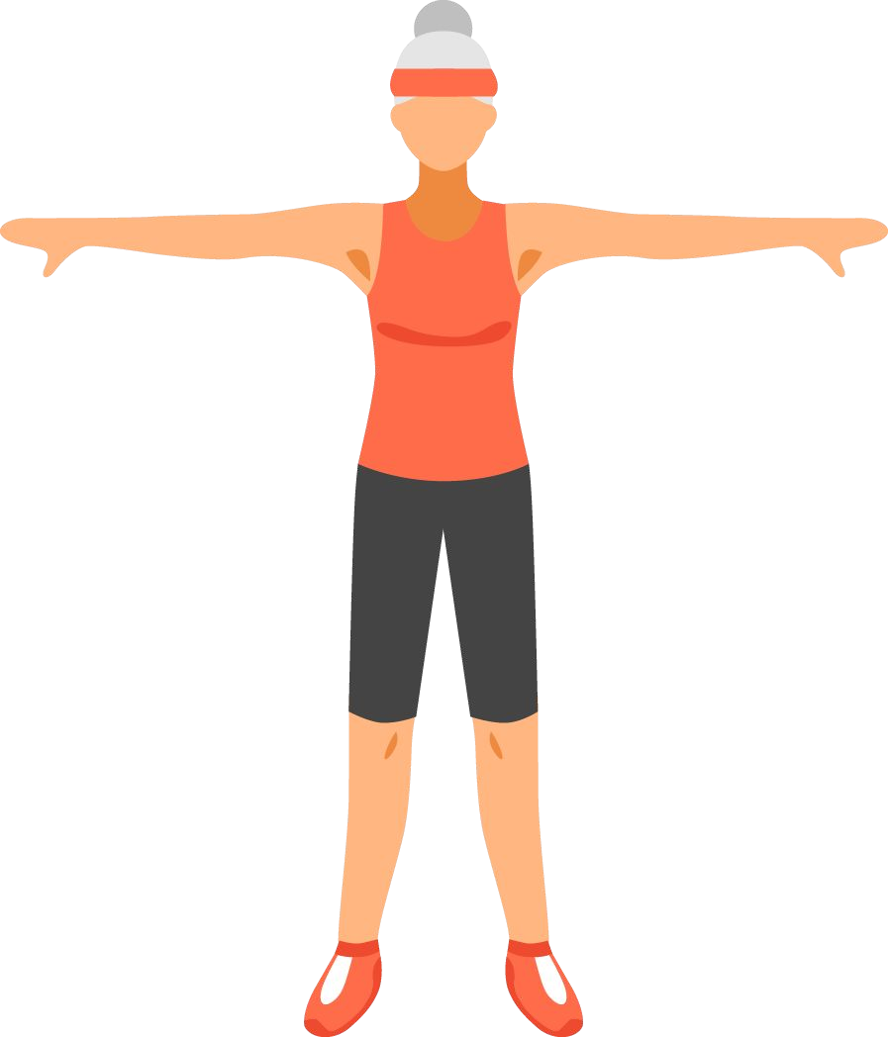
User Persona
Meet John!
He is a 32-year-old guy who loves eating but also wants to lose weight. Because of lockdown, he is not able to access the gym anymore.
With very little motivation without a gym environment, he is ﬁnding it hard to workout at home.
Meet Abby!
Abby is a 56-year-old woman who loves to do warm-up exercises and evening walk at a nearby park. Due to lockdown, she is not able to do it anymore. Her friend suggested installing CureFit app.
Meet Roy!
Roy is a 21-year-old college guy who loves to hit the gym regularly. He is very conscious about his physique. During this lockdown, he is looking for an online session where he can strengthen and condition his muscles.

Slide 4
John’s pain point
No starting point: John as new to the app doesn’t know where to start his journey.
Choice overload: Too many choices in a different style of workout result in a long time to make decisions and frustration.
No user journey: John is looking for weight loss but no exact idea about the kind of workout he needs to pick to lose weight at a particular time.
No sneak peek in live classes: John doesn’t know while booking live class on what kind of exercises he will be expecting.
No incentive: John has a motivation problem and he is not able to motivate him enough to come back on the app and book a class.

Slide 5
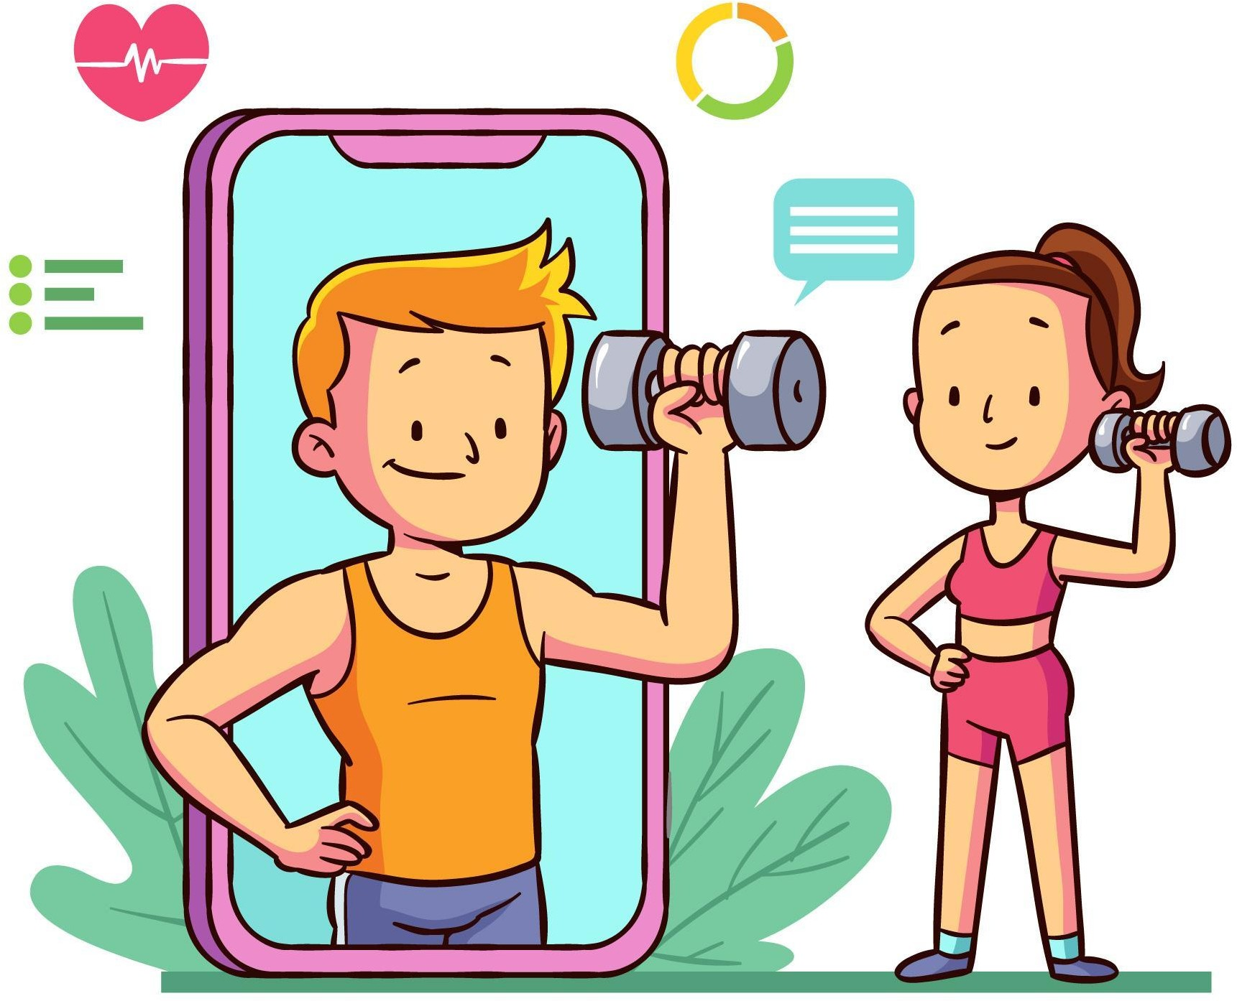
Product Features

Slide 6
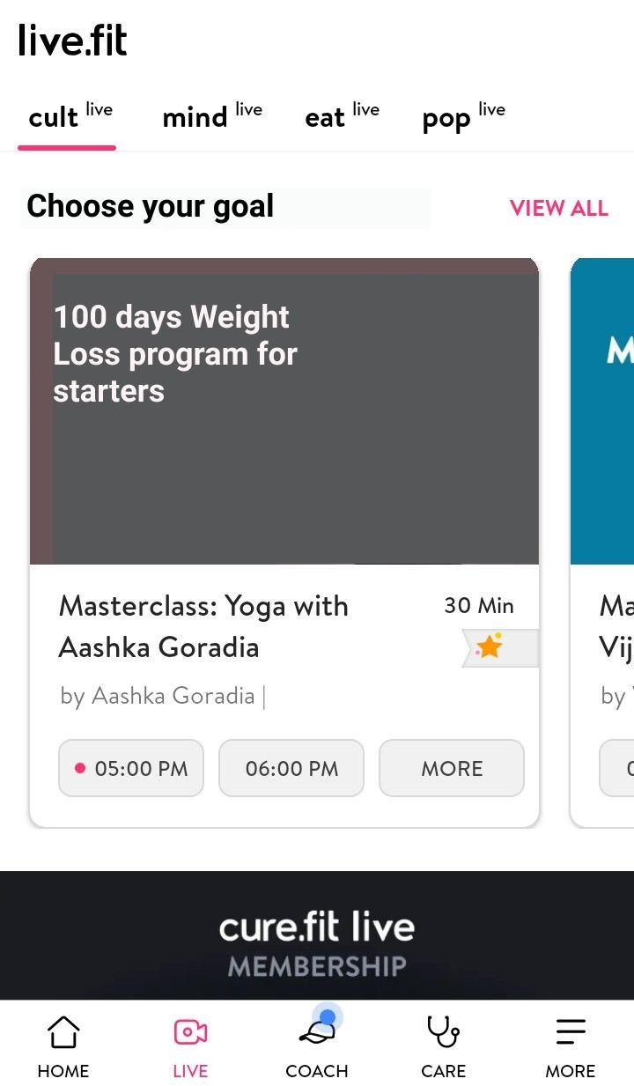
Feature 1: Health journey path for users.
User can choose their paths according to the fitness goals.
This will give an anchor to user and will help in making decisions. This path will help users to understand how their journey looks like to motivate them to complete journey which results to increase user engagement.
This journey bar will show users how much they have completes the path and how much path is remaining and thus motivating them to push harde everyday.

Slide 7
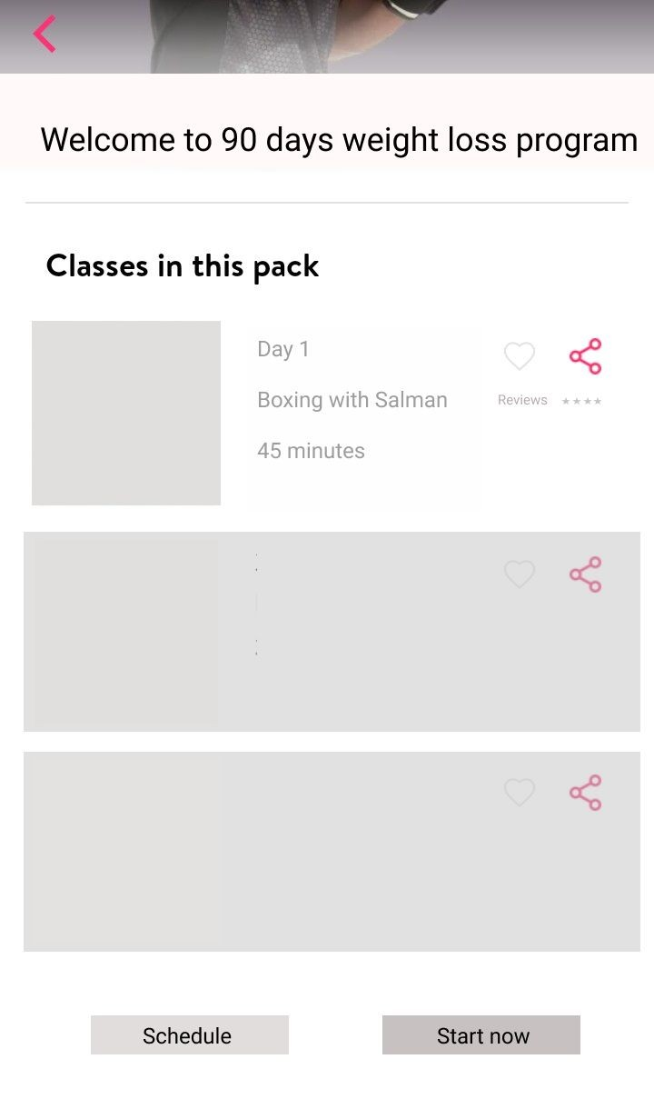
Feature 1: Health journey path for users.
When user choose any path, then journey shown in figure will be visible. Information would be provided to user on what he/she shall be expecting on D1, D2 etc.
Receding workouts will be greyed out but user can take a sneak peak on what kind of workouts he will be doing.
User rating will act as a social proof.
User can start their journey anytime.

Slide 8
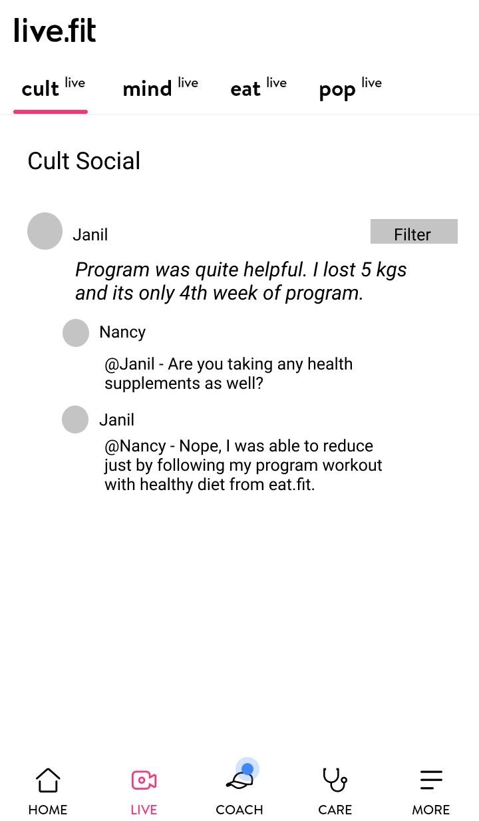
Feature 2 : Cult Social
Q&A page where fellow users who have joined same path can interact, share their experience and publish their results.
Bandwagon effect: When user believes on something because other people are doing he same. When other people will talk about their results it will motivate user. This cognitive bias will help users re-engage them with the platform and hook them to app.
Filter option: User can filter on the basis of city they are in or can switch path.

Slide 9
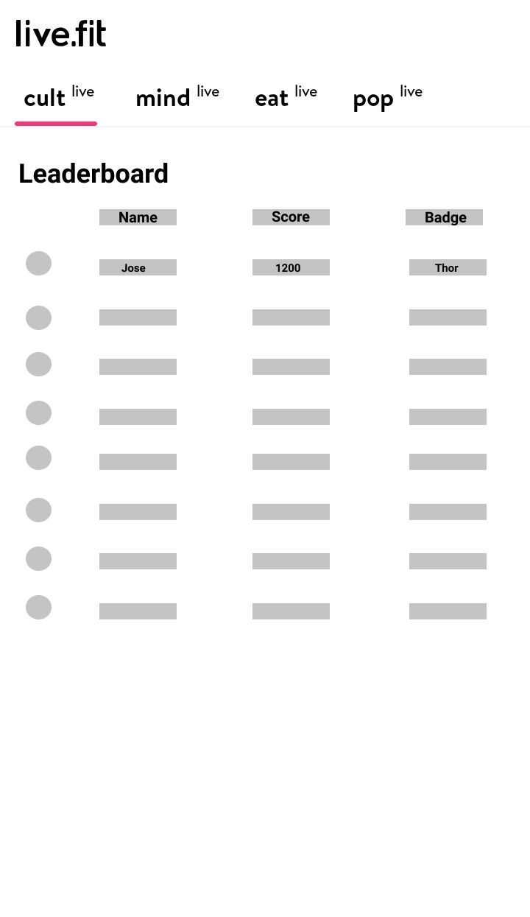
Feature 3: Leaderboard
Scores: After every workout scores will be given to user. Different in case if user misses 1 or ‘X’ no. of days in between two consecutive session
Levelization: Levels will be created at certain threshold of scores. Special perks will be attached to every level which will incentivize user.
Names and scores will be published on the basis of their ranks. This leaderboard will contain all users based on the city they are in. Though the maximum limit in one group should be 500.
Badges will be given to users according to their levels. It will be displayed on user’s homepage.

Slide 10
Success Metrics
Retention Rate.
User Growth Rate
Stickiness = DAU/MAU
Average Revenue per User
No. of referrals per user
Daily App Launches
Session Duration
Session Interval

Slide 11
Additional consideration
Too much competition: While applying levelization and badges feature to the app there maybe users who are not able to spend time daily for workout, which will result into decrease in there rank and user might uninstall the app due to frustration.
Recommendation engine: Applying ML models in the app will act as safe havens for users and protect them from churn. Regularly suggesting them the best exercises according to the user consumption of content.

